Slide 1
Logos
Research Experience for High-School Students -- REHS
June – August (8 weeks)

Slide 2







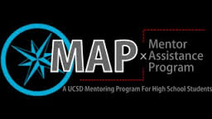
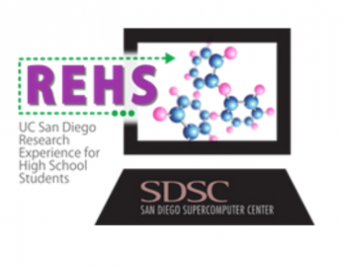
MANDATORY:
UCSD SDSC
REHS
YOUR School

